Slide 1
Do discharge-recharge processes responsible for the MJO onset and propagation during DYNAMO?
Xingchao Chen and Fuqing Zhang

Slide 2
Madden Julian Oscillation (MJO)
Composite OLR (1979-2004 November-May) Gottschalck et al.
1. The MJO is characterized by an eastward progression of large regions of both enhanced and suppressed tropical rainfall, observed mainly over the Indian and Pacific Ocean.
2. The MJO moves eastward at between 4 m/s and 8 m/s across the tropics, crossing the Earth's tropics in 20 to 100 days

Slide 3
Hypotheses explaining the mechanisms through which the onset and propogation of convection occurs over the Indian Ocean include:
Circumnavigating theory: circumnavigating upper tropospheric velocity potential and zonal wind anomalies occurring as a Kelvin wave response to a previous MJO may trigger the next MJO (e.g., Knutson and Weickmann, 1987)
Discharge-recharge theory: humidity gradually increase in the lower to middle troposphere (cumulus clouds re-conditioning, 10 to 15 days prior to MJO onset), and a new MJO cycle commences once the atmosphere becomes sufficiently unstable and moist to support deep convection again (e.g., Blade and Hartmann, 1993)
(3) Others like extra-tropical influences (e.g., Ray and Li, 2013)

Slide 4
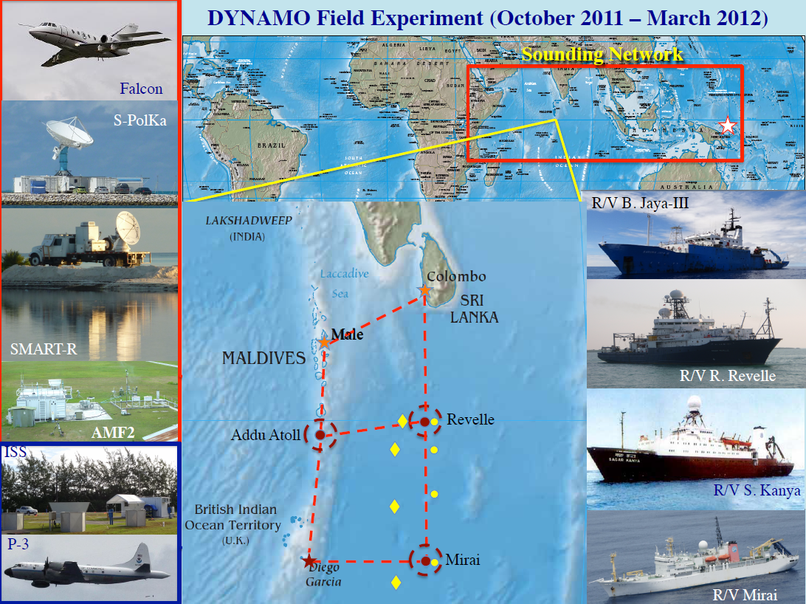
1.2 CINDY/DYNAMO Campaign
http://catalog.eol.ucar.edu/dynamo/index.htm

Slide 5
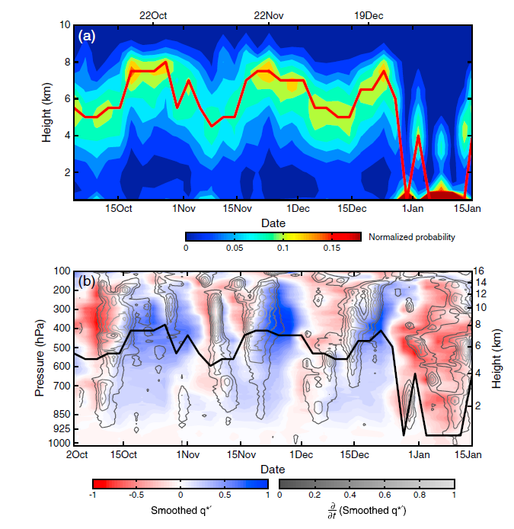
Echo Top probability
Fractional difference of humidity
Powell and Houze, 2013

Slide 6
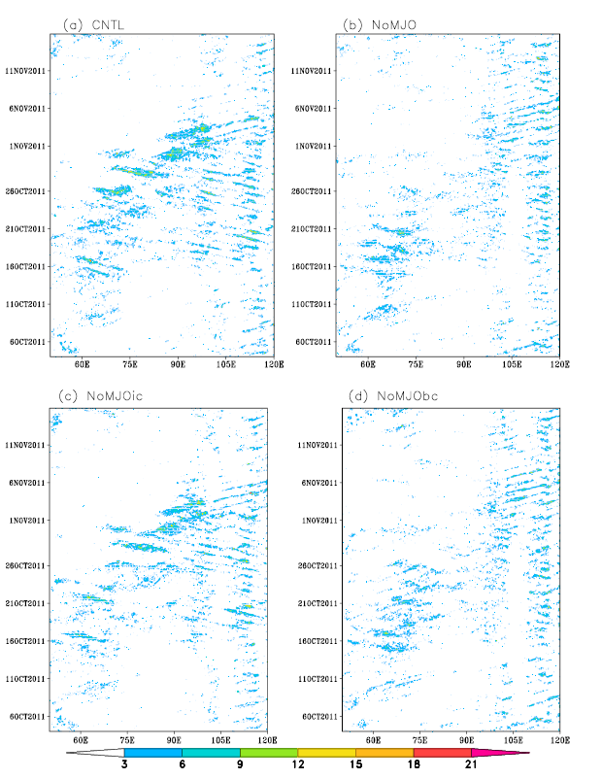
Zhang et al., 2017

Slide 7
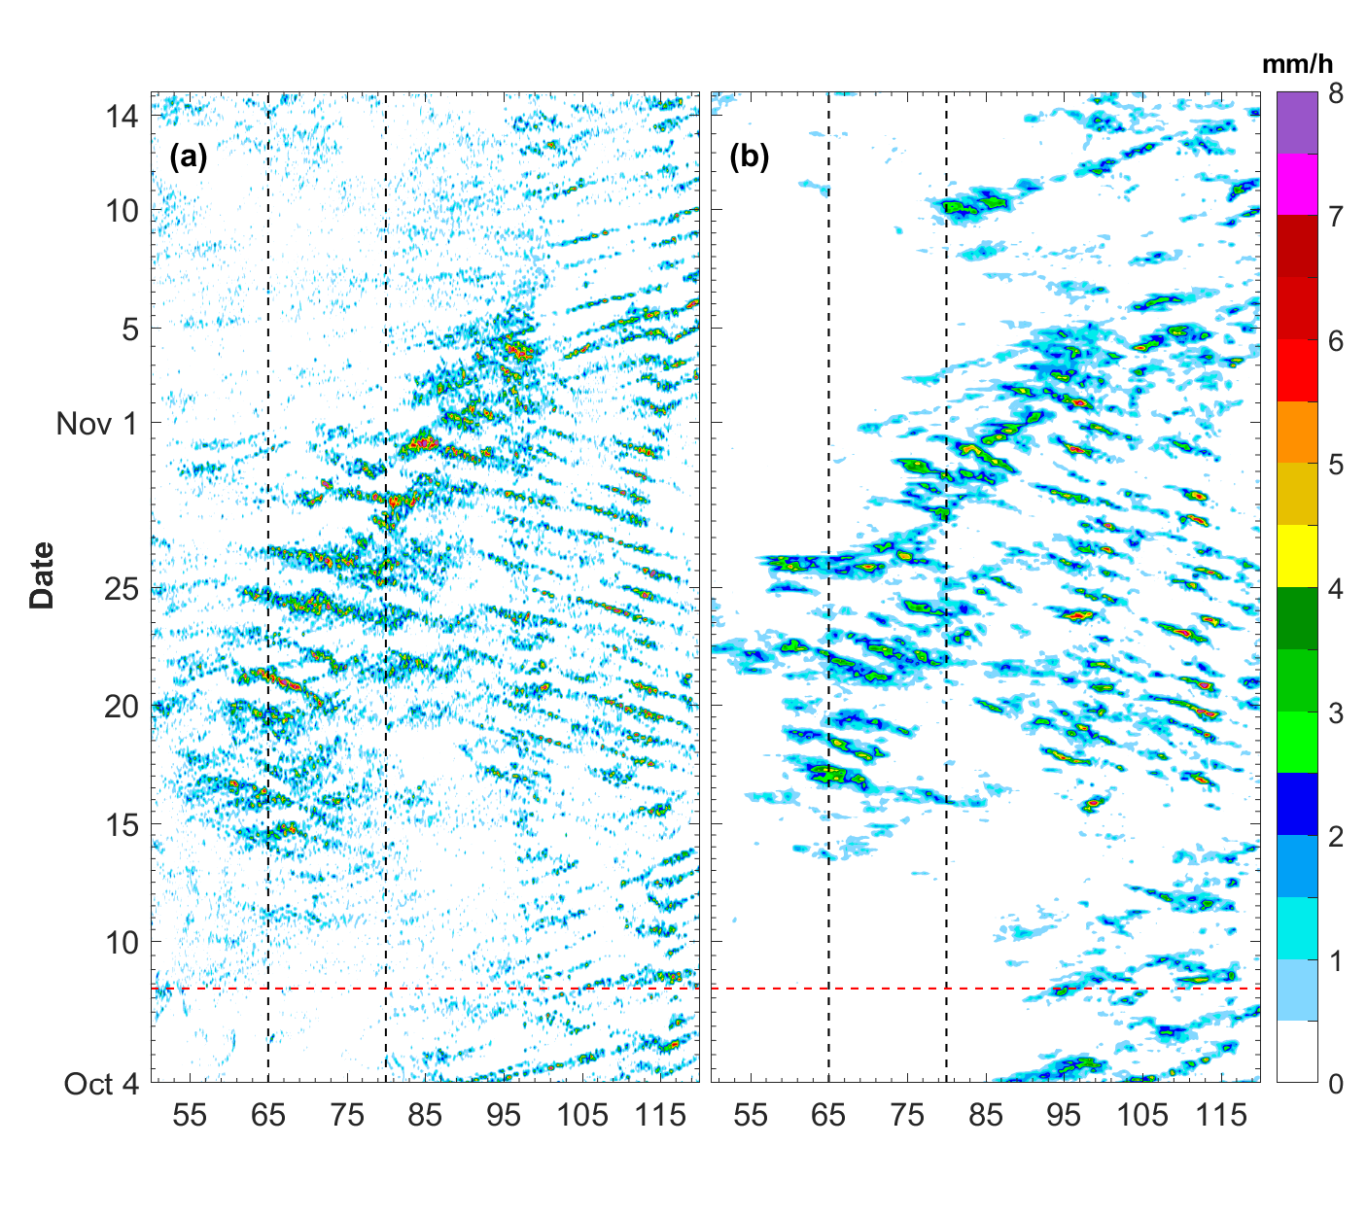
CNTL
TRMM
Precipitation
RH

Slide 8
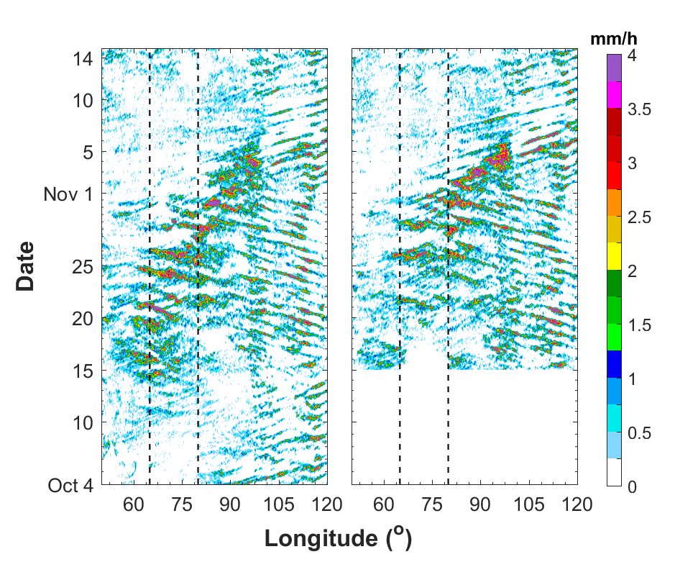
Precipitation
CNTL
DRY

Slide 9
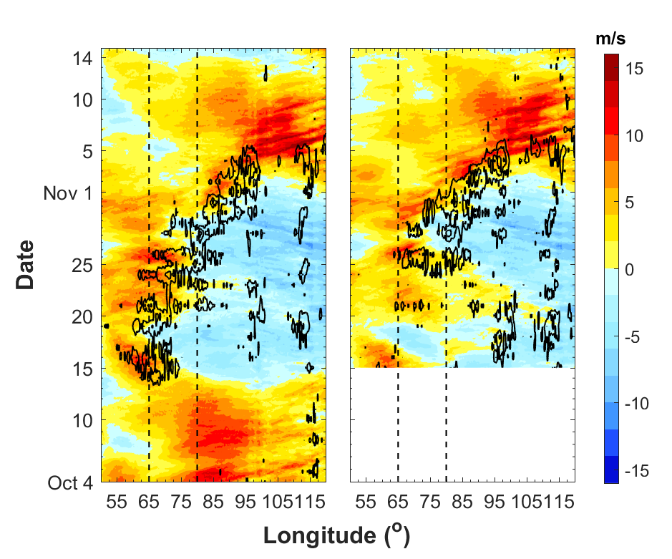
zonal wind at 850 hPa
CNTL
DRY

Slide 10
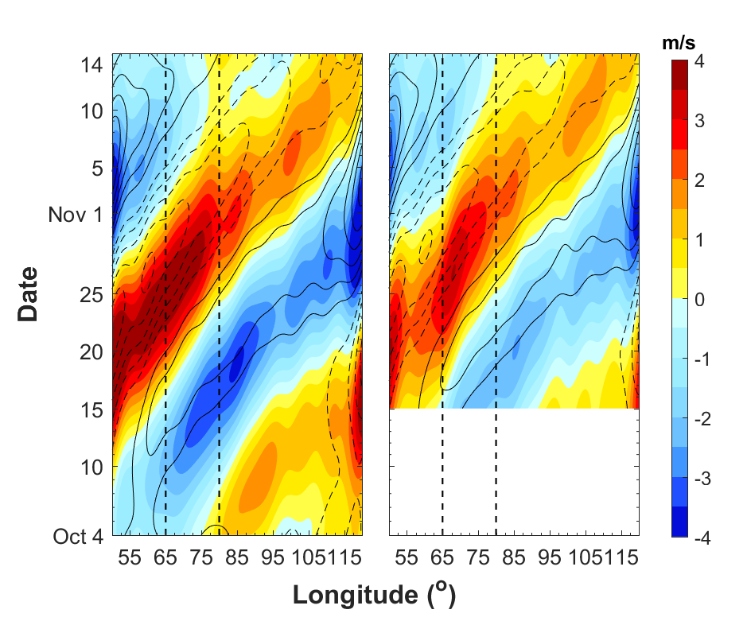
MJO-filtered zonal wind at 200 and 850 hPa
CNTL
DRY

Slide 11
RH

Slide 12
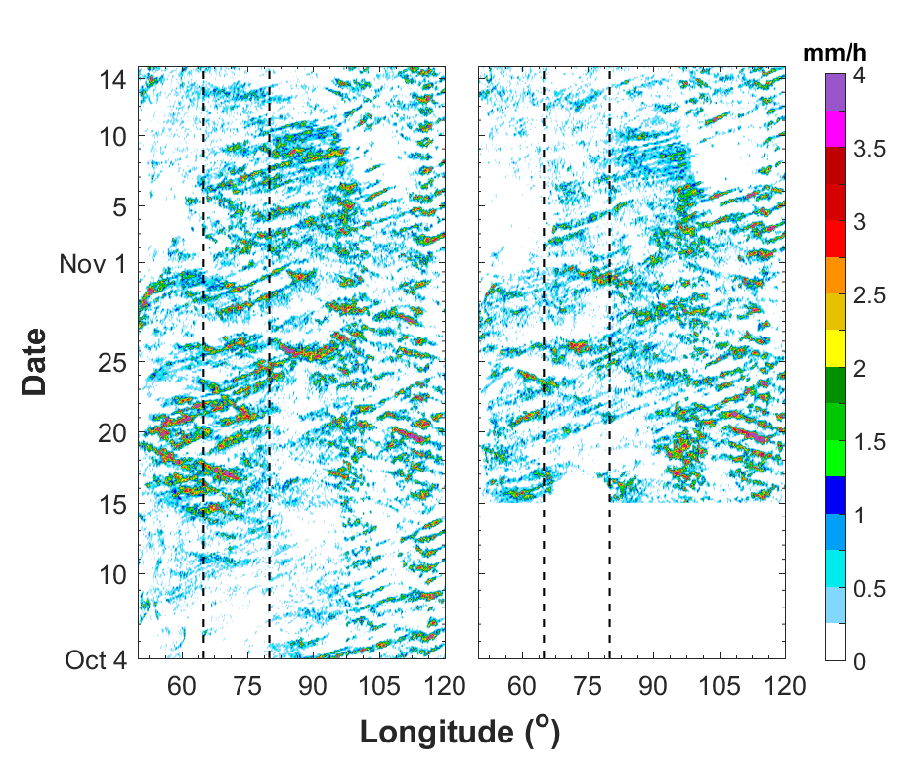
Precipitation
CNTL-noMJO
DRY-noMJO

Slide 13
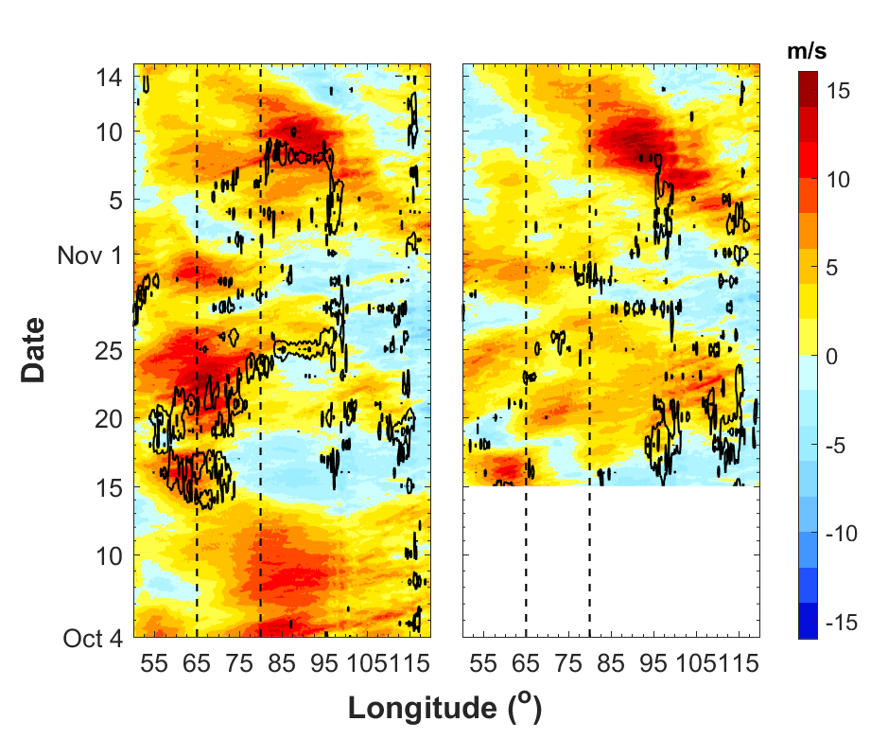
zonal wind at 850 hPa
CNTL-noMJO
DRY-noMJO

Slide 14
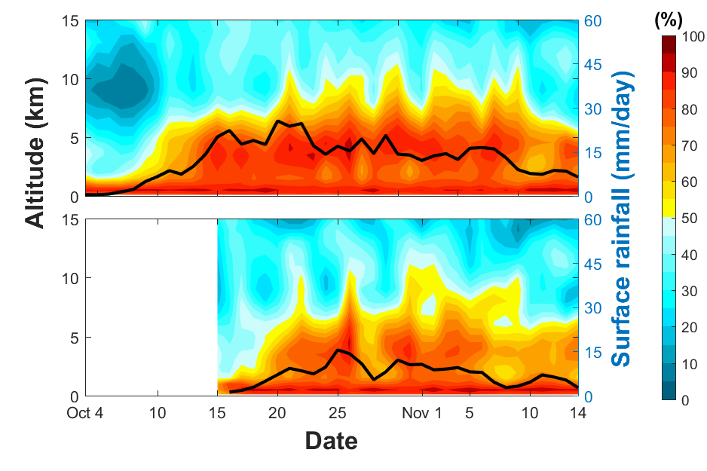
RH

Slide 15
Conclusions：
The propagation and convective initiation of the October MJO are not closely related to the “pre-conditioning” or the cumulus moistening processes
The sensitivity experiments show that the circumnavigating dry mode of the MJO is the main controller of MJO onset

Slide 16
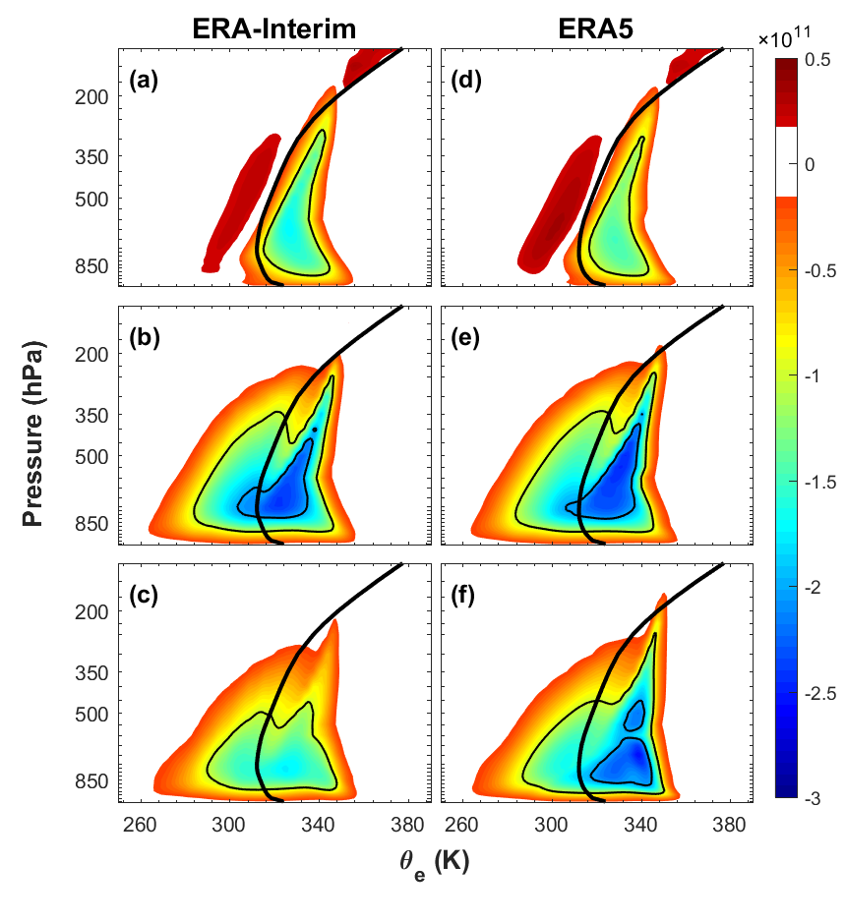

Slide 17
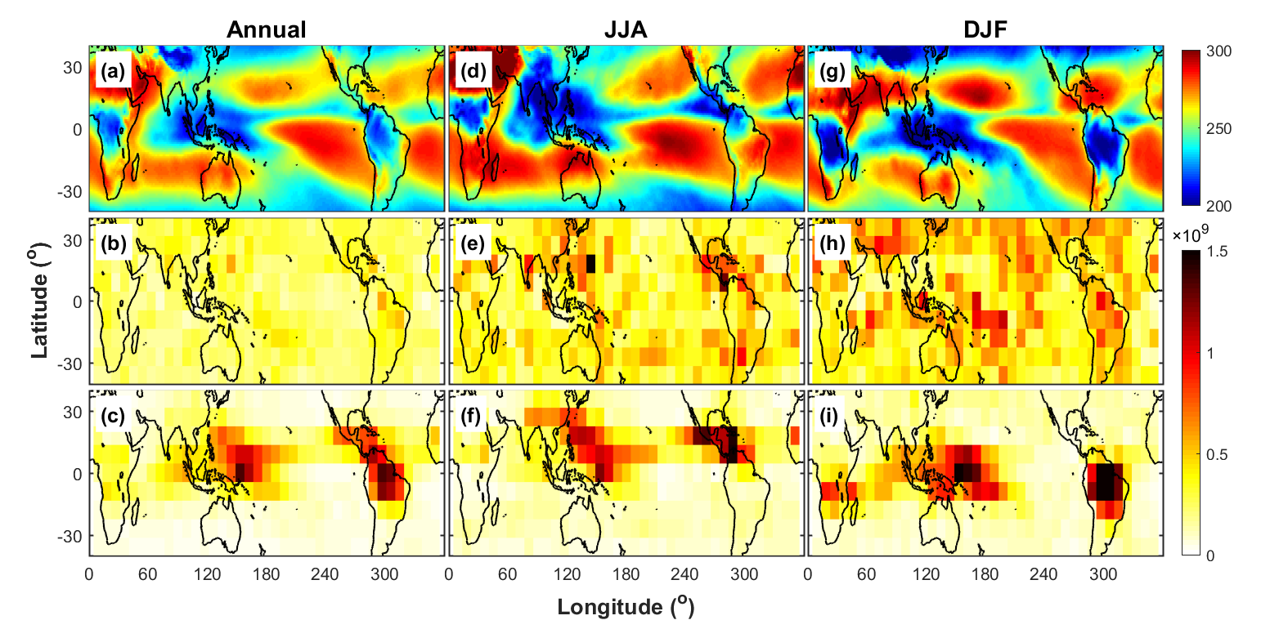
OLR
ERAI
ERA5

